Slide 1
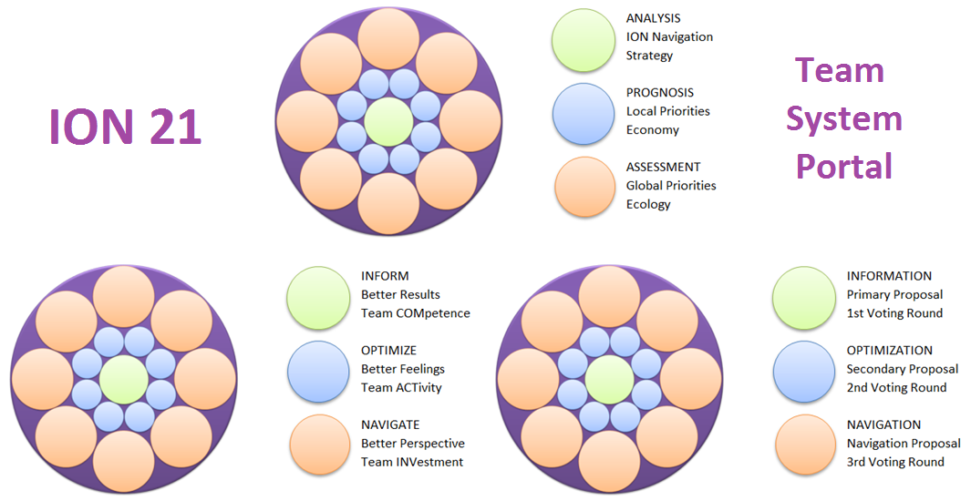
ION 21 Team System Portal
Decision-making and motivation forecasting system for the 21st century

Slide 2
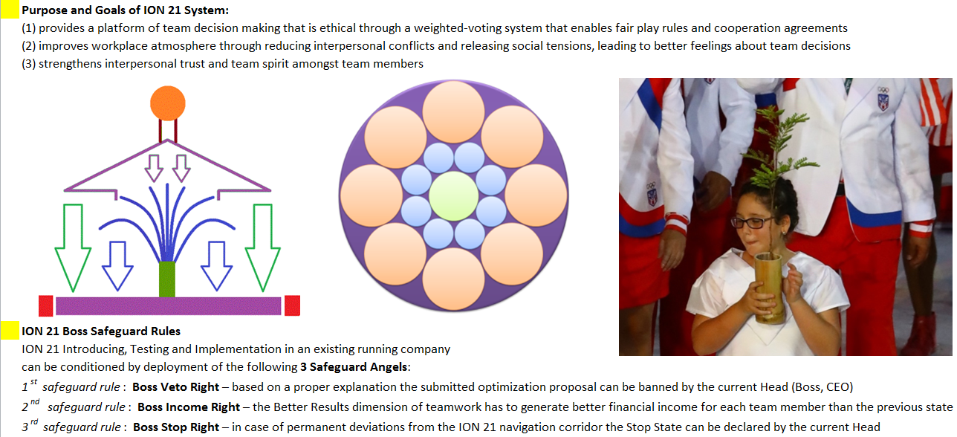
ION 21 Team System Portal

Slide 3
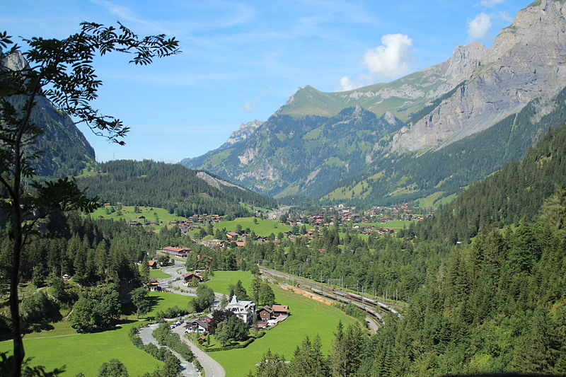
ION 21 Team System Portal
KANDERSTEG

Slide 4
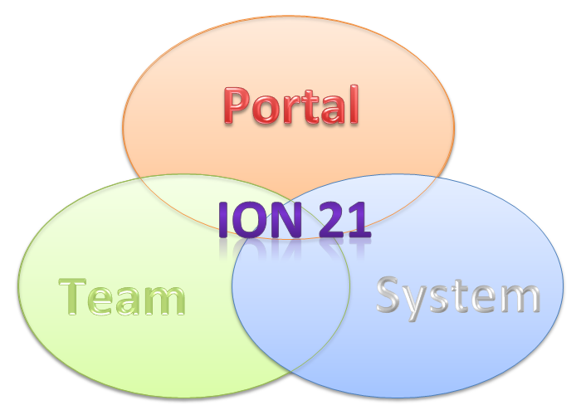
ION 21 Team System Portal
Purpose and Goals of ION 21 System:
provides a platform of team decision making that is ethical through a weighted-voting system that enables fair play rules and cooperation agreements
improves workplace atmosphere through reducing interpersonal conflicts and releasing social tensions, leading to better feelings about team decisions
strengthens interpersonal trust and team spirit amongst team members

Slide 5
ION 21 Team System Portal
ION 21 Decision framework:
Procedural decision (directives) - autonomous control according to a relevant directive, for example driver's activity in accordance with traffic rules.
Operational decision (consensus) - working meeting to cope with current challenges, with discussion to find a consensus, e.g. coordination of daily activities.
Strategical decision (prognoses) - optimizing of the cooperation strategy based on forecasted proposals, for example setting of cooperation parameters.

Slide 6
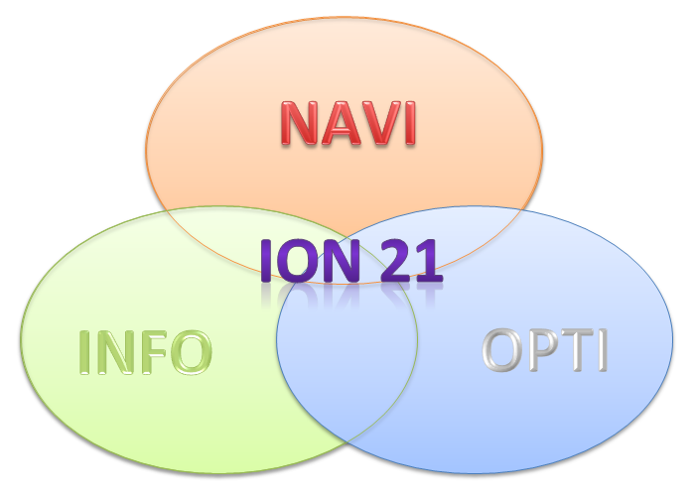
ION 21 Team System Portal
ION 21 Team Processes: Information, Optimization, Navigation

Slide 7
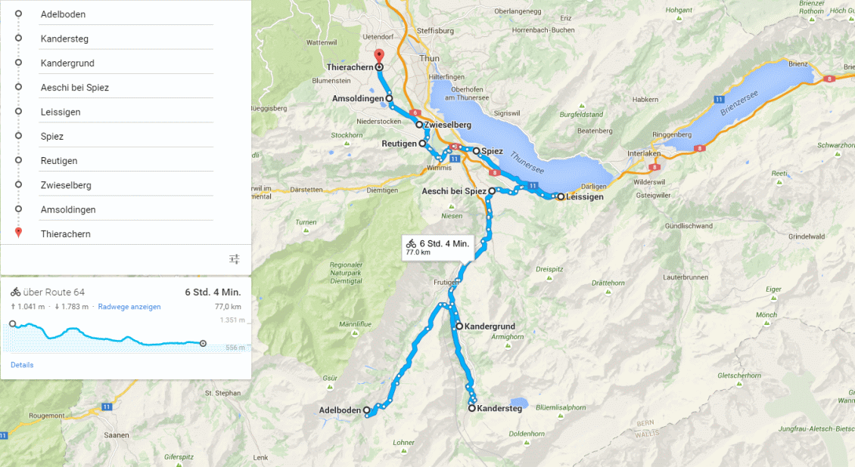
ION 21 Team System Portal

Slide 8
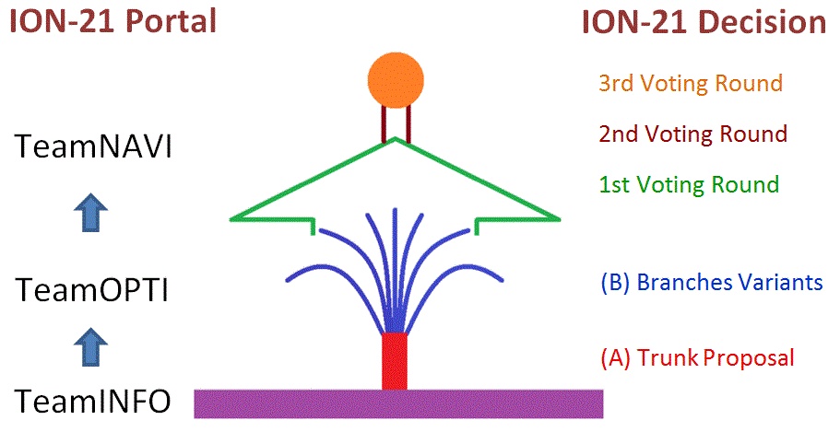
ION 21 Team System Portal
ION 21 Decision-making procedure

Slide 9
ION 21 Team System Portal
ION 21 Navigation process

Slide 10
ION 21 Team System Portal
ION 21 Team motivation: 21 Shared Votes

Slide 11
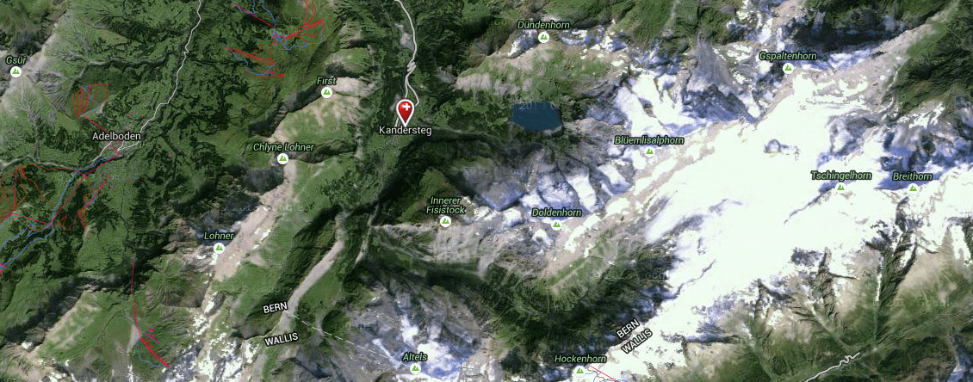
ION 21 Team System Portal
Kandersteg lies at an altitude of 1'174 meters, has 1'230 inhabitants and an area of 135 km². The main tourist destination is Lake Oeschinensee 1'578 m asl.

Slide 12
ION 21 Team System Portal
ION 21 Navigation: First Voting Round

Slide 13
ION 21 Team System Portal
ION 21 Navigation: Second Voting Round

Slide 14
ION 21 Team System Portal
ION 21 Navigation: Third Voting Round

Slide 15
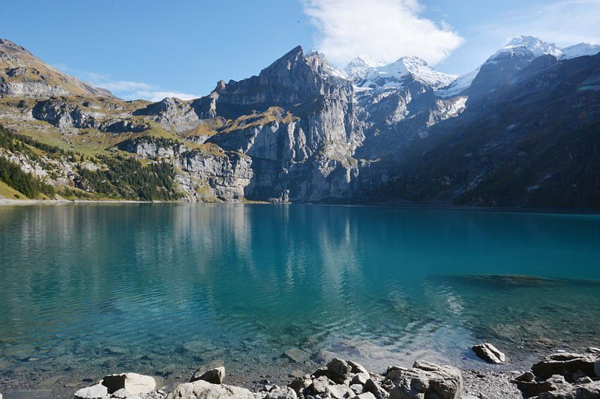
ION 21 Team System Portal

Slide 16
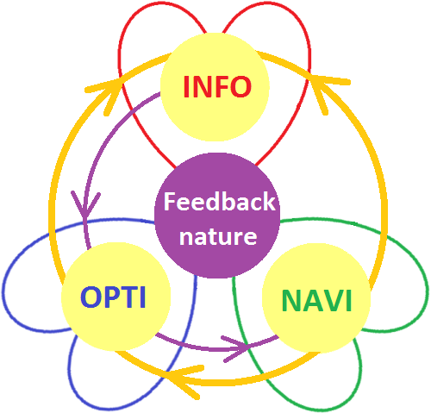
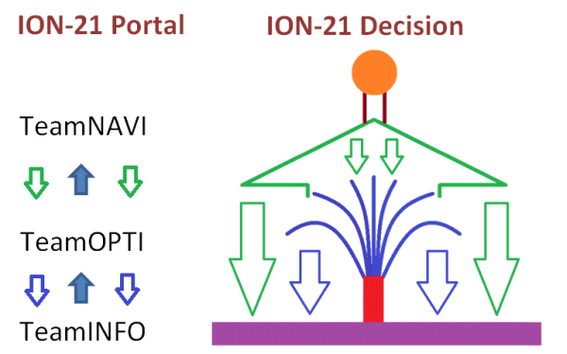
ION 21 Team System Portal
ION 21 Decision-making: Feedback nature

Slide 17
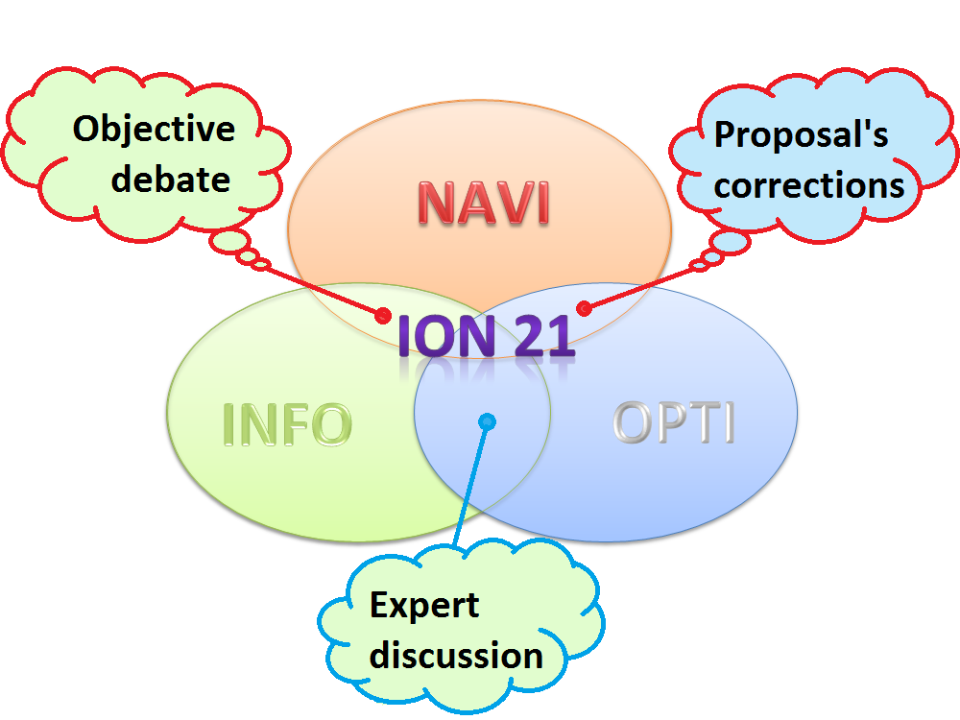
ION 21 Team System Portal
ION 21 Decision-making: Iterative nature

Slide 18
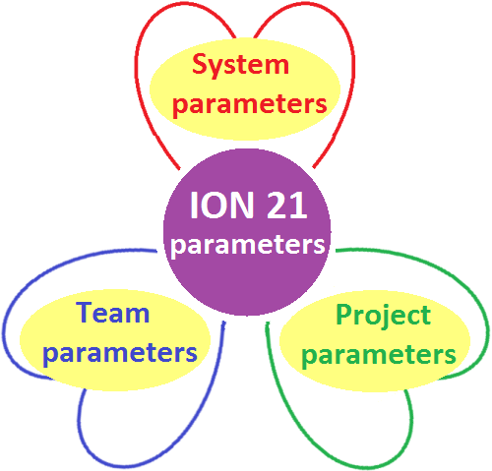
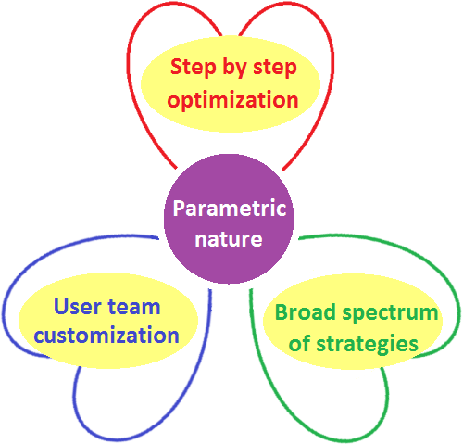
ION 21 Team System Portal
ION 21 Decision-making: Parametric nature

Slide 19
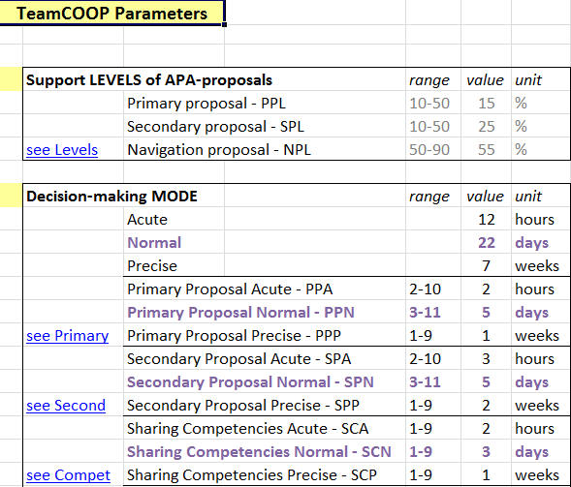
ION 21 Team System Portal
ION 21 TeamCOOP Parameters: System, Team, Project

Slide 20
ION 21 Team System Portal
ION 21 Parameters: Setting tables

Slide 21
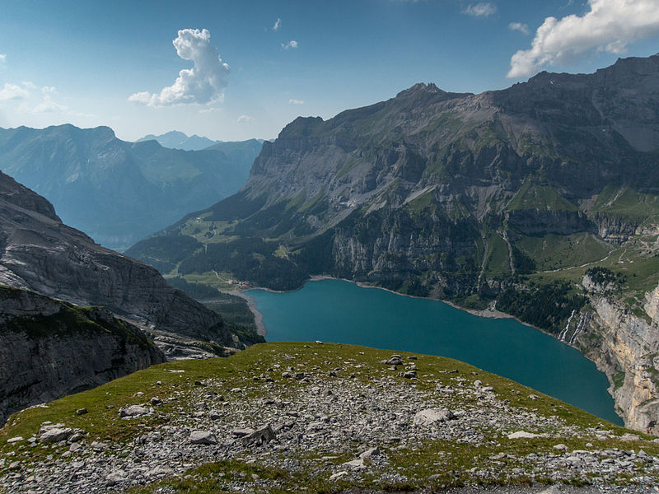
Kandersteg

Slide 22
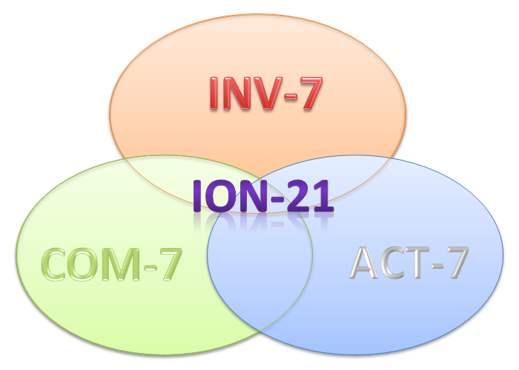
ION 21 Team System Portal
ION 21 Team motivation: Competence, Activity, Investment

Slide 23
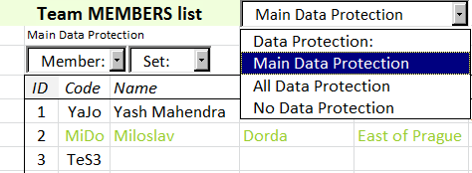
ION 21 Team System Portal
ION 21 Team: Member table

Slide 24
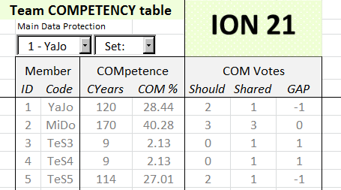
ION 21 Team System Portal
ION 21 Team: Competency table

Slide 25
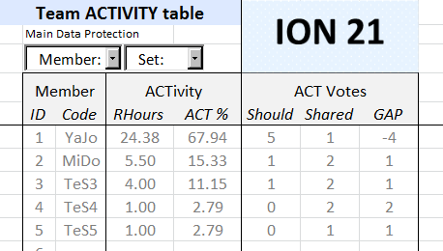
ION 21 Team System Portal
ION 21 Team: Activity table

Slide 26
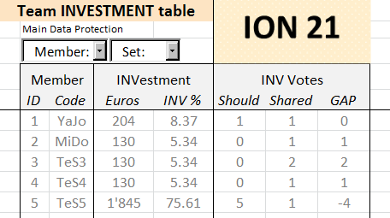
ION 21 Team System Portal
ION 21 Team: Investment table

Slide 27
ION 21 Team System Portal

Slide 28
ION 21 Team System Portal
ION 21 Team motivation: 21 Shared Votes

Slide 29
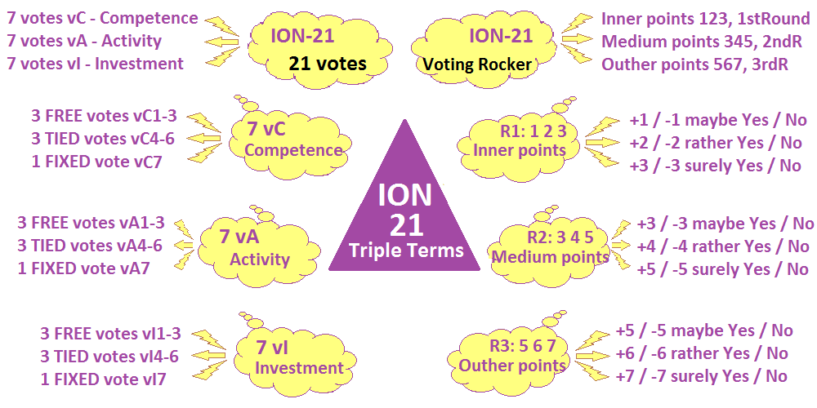
ION 21 Team System Portal
ION 21 Voting: 7 degrees of freedom -3 -2 -1 0 +1 +2 +3

Slide 30
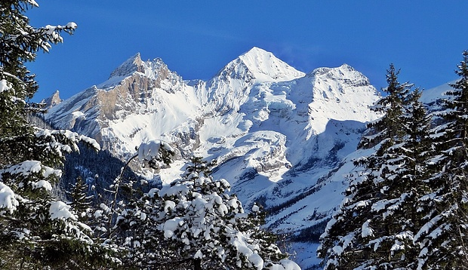
ION 21 Team System Portal

Slide 31
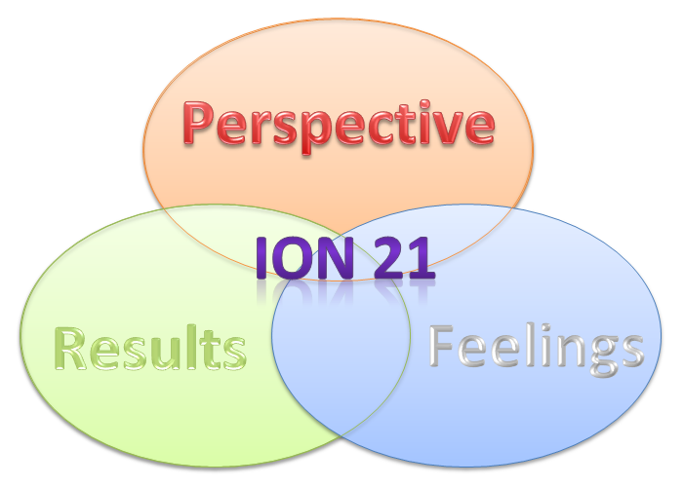
ION 21 Team System Portal
ION 21 Navigation dimensions: Better Results, Better Feelings, Better Perspective

Slide 32
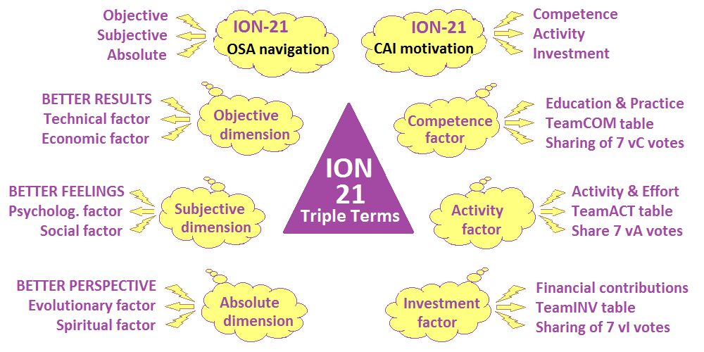
ION 21 Team System Portal
ION 21 Navigation OSA-corridor: Objective, Subjective, Absolute

Slide 33
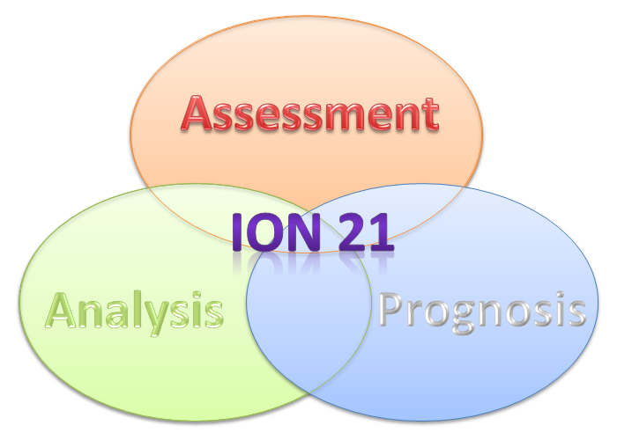
ION 21 Team System Portal
ION 21 Optimization proposal supplements: Analysis, Prognosis, Assessment

Slide 34
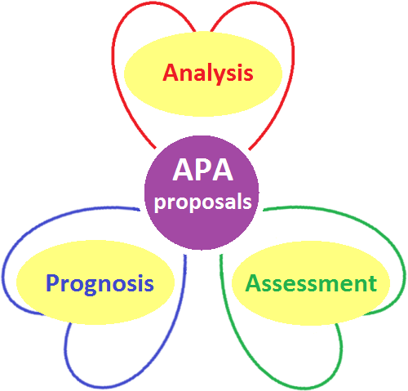
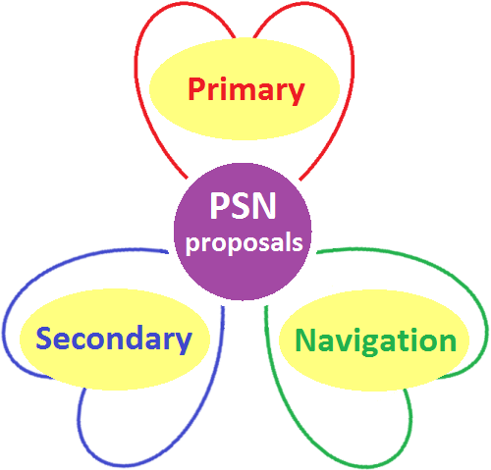
ION 21 Team System Portal
ION 21 Optimization APA-proposals: Analysis, Prognosis, Assessment

Slide 35
ION 21 Team System Portal
ION 21 Proposals: Primary, Secondary, Navigation
A key element of the team decision making is the quality of optimization proposals
to improve the cooperation strategy presented and assessed by all team members.

Slide 36
ION 21 Team System Portal
ION 21 Proposal’s Corrections: First, Second, Third

Slide 37
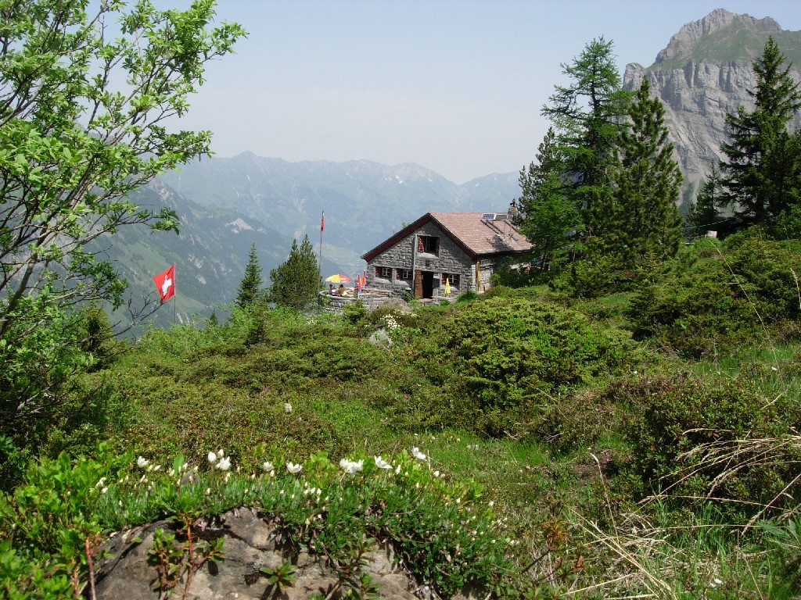
ION 21 Team System Portal

Slide 38
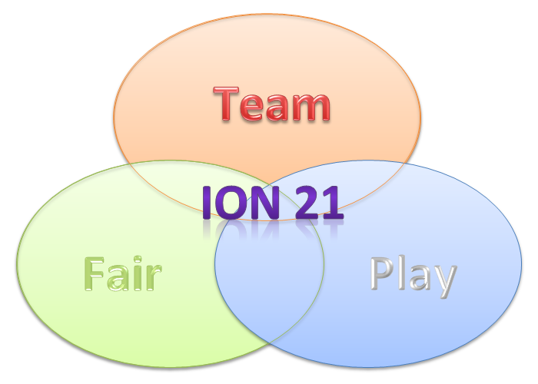
ION 21 Team System Portal
ION 21 Fair Play Teamwork

Slide 39
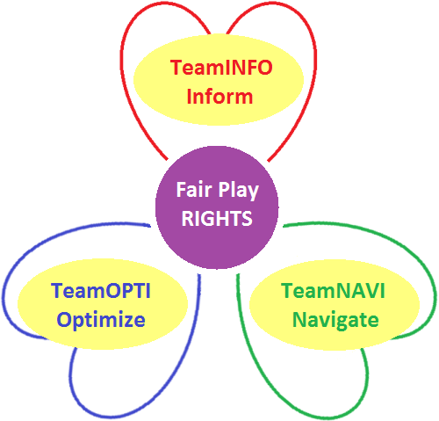
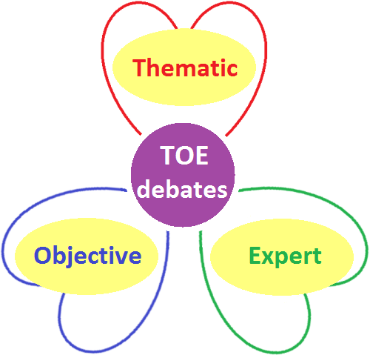
ION 21 Team System Portal
ION 21 Fair Play Rights: Inform, Optimize, Navigate
1. FAIR PLAY RIGHT on the equal sharing of all project information to all team members
2. FAIR PLAY RIGHT on submission of forecasted proposals for teamwork improvement
3. FAIR PLAY RIGHT on decision-making of team strategy and cooperation parameters

Slide 40
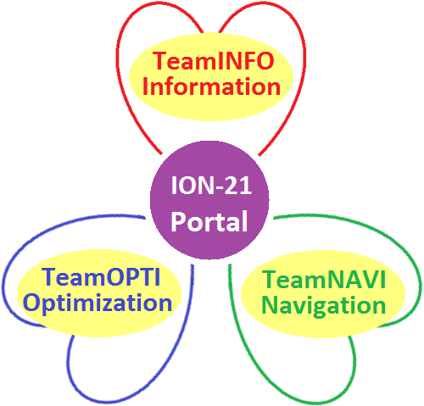
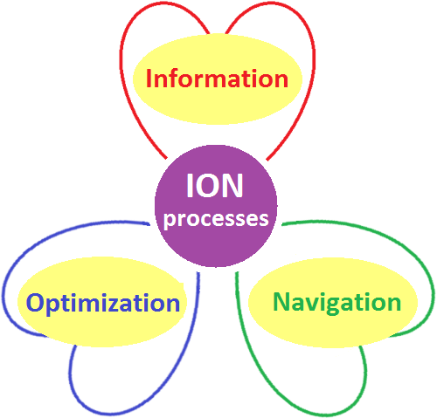
ION 21 Team System Portal
ION 21 Portal: TeamINFO, TeamOPTI, TeamNAVI

Slide 41
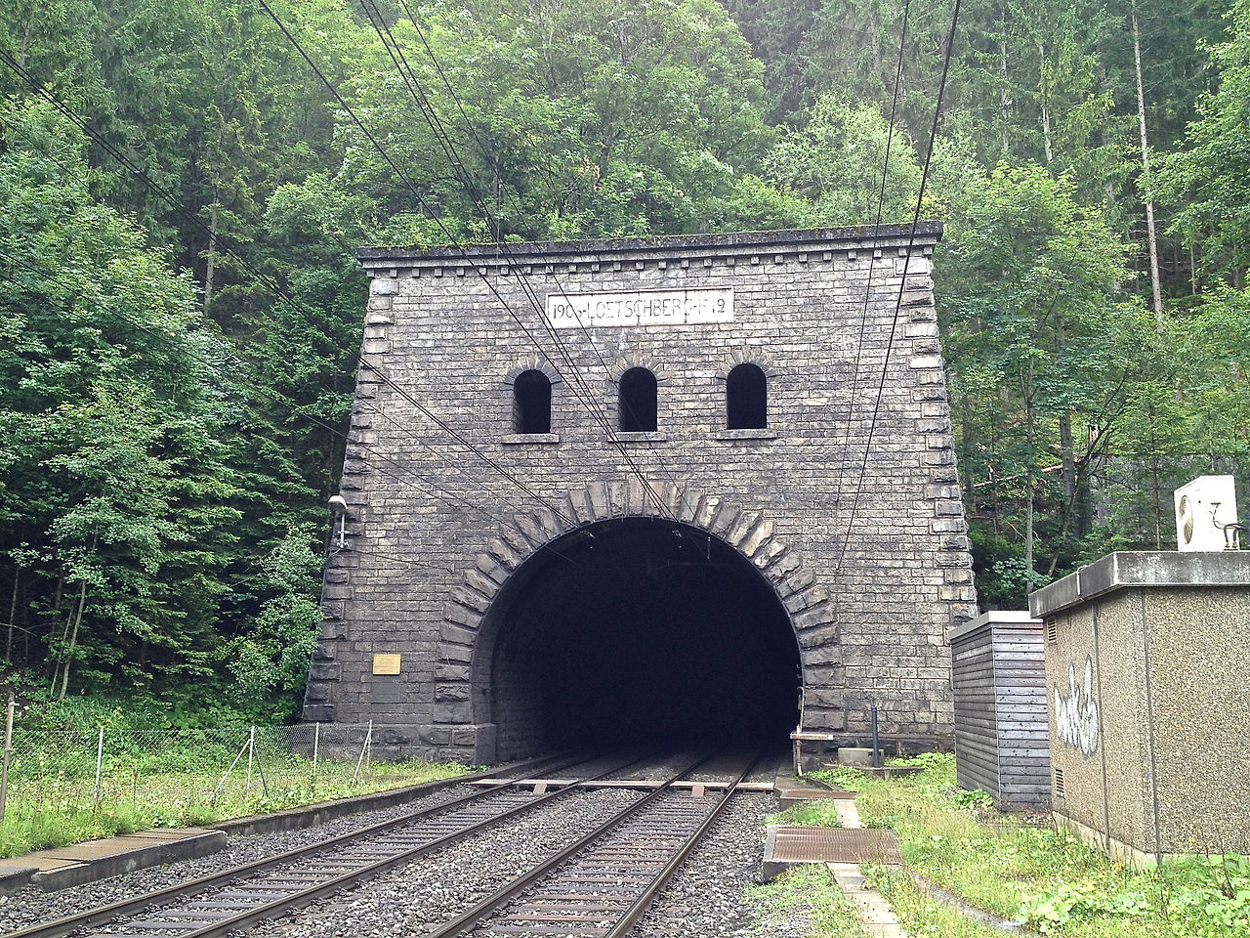
ION 21 Team System Portal

Slide 42
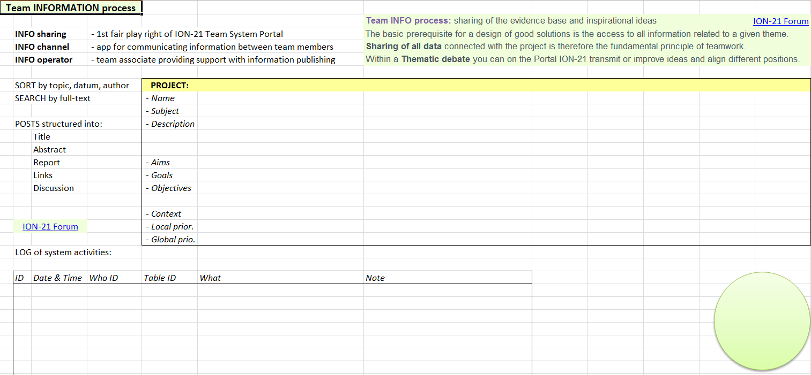
ION 21 Team System Portal
ION 21 Portal: TeamINFO process

Slide 43
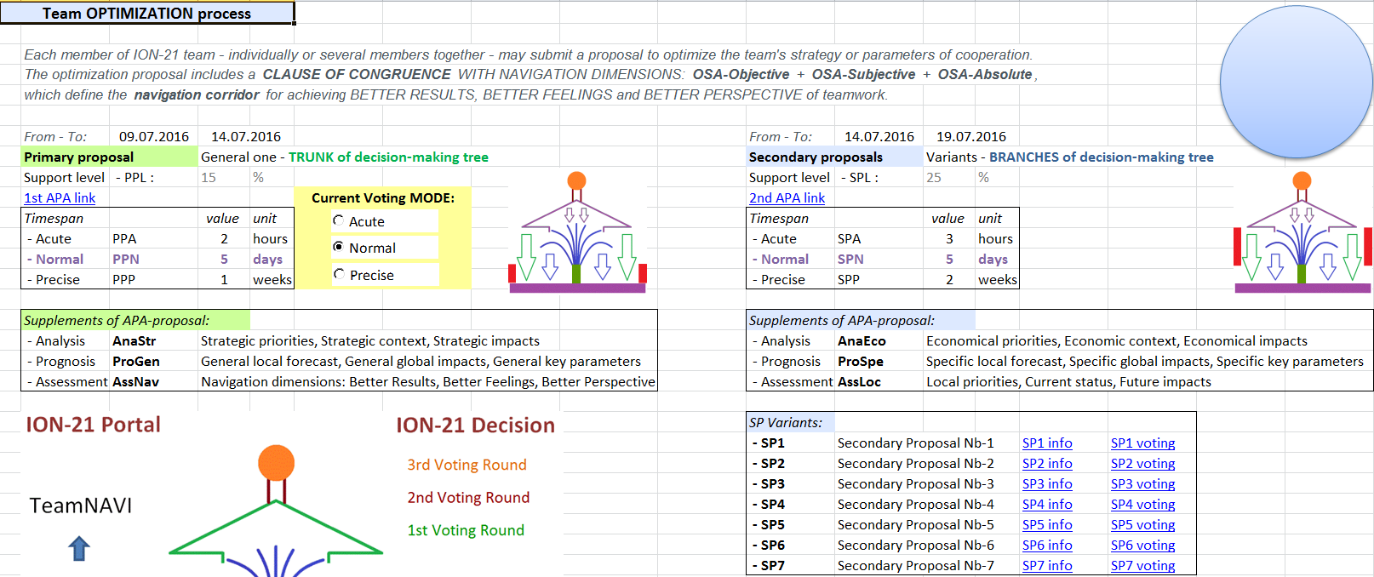
ION 21 Team System Portal
ION 21 Portal: TeamOPTI process

Slide 44
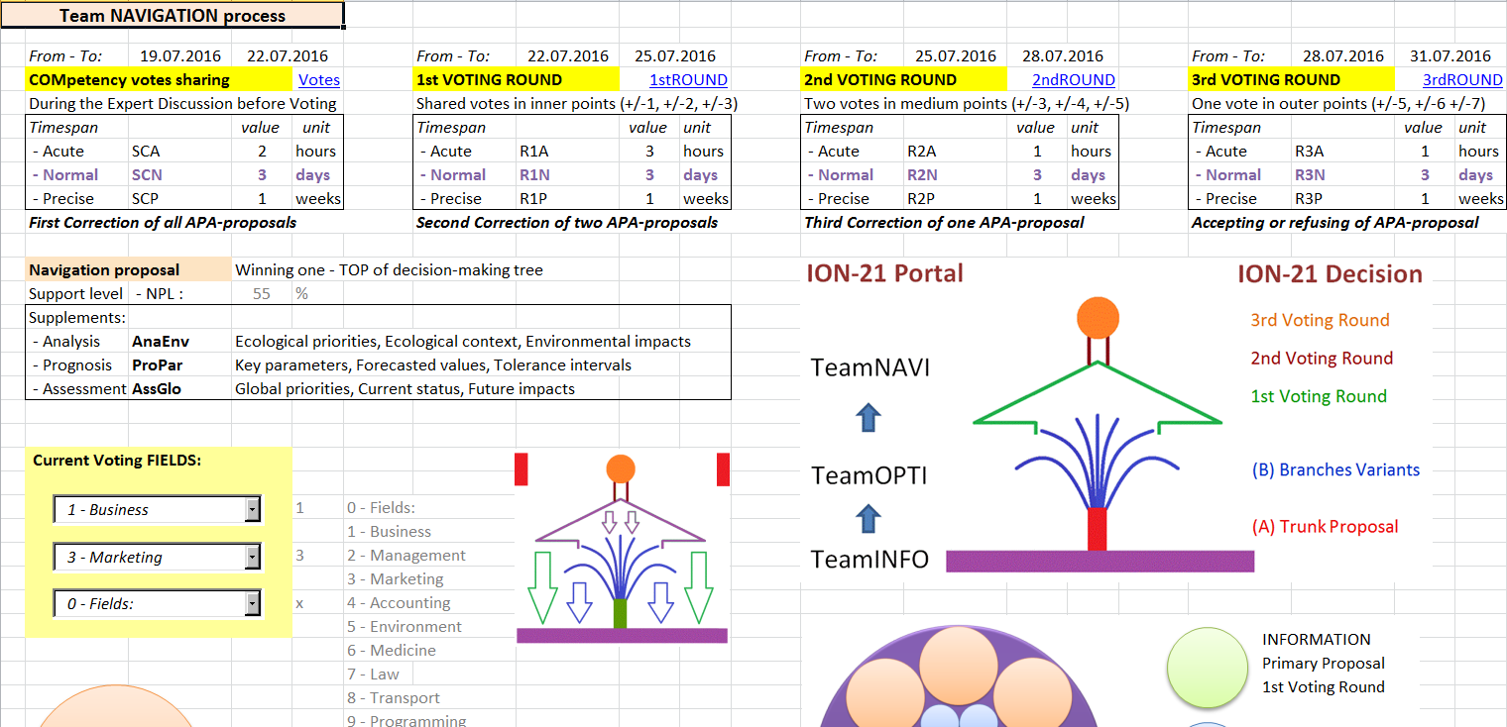
ION 21 Team System Portal
ION 21 Portal: TeamNAVI process

Slide 45
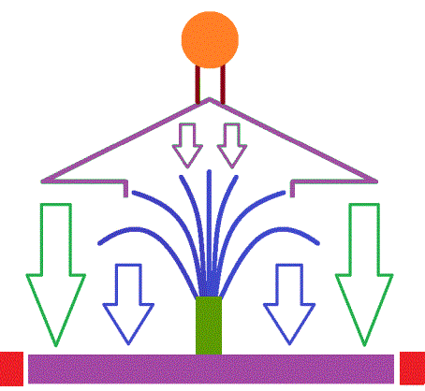
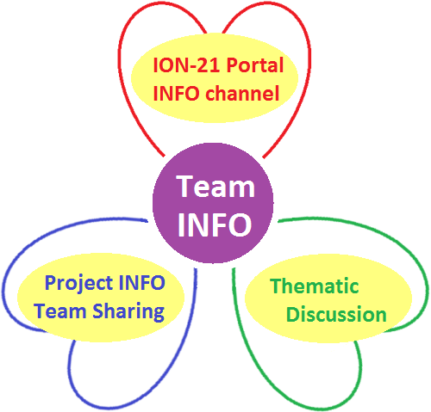
ION 21 Team System Portal
ION 21 Information: Base and roots of the Solution tree

Slide 46
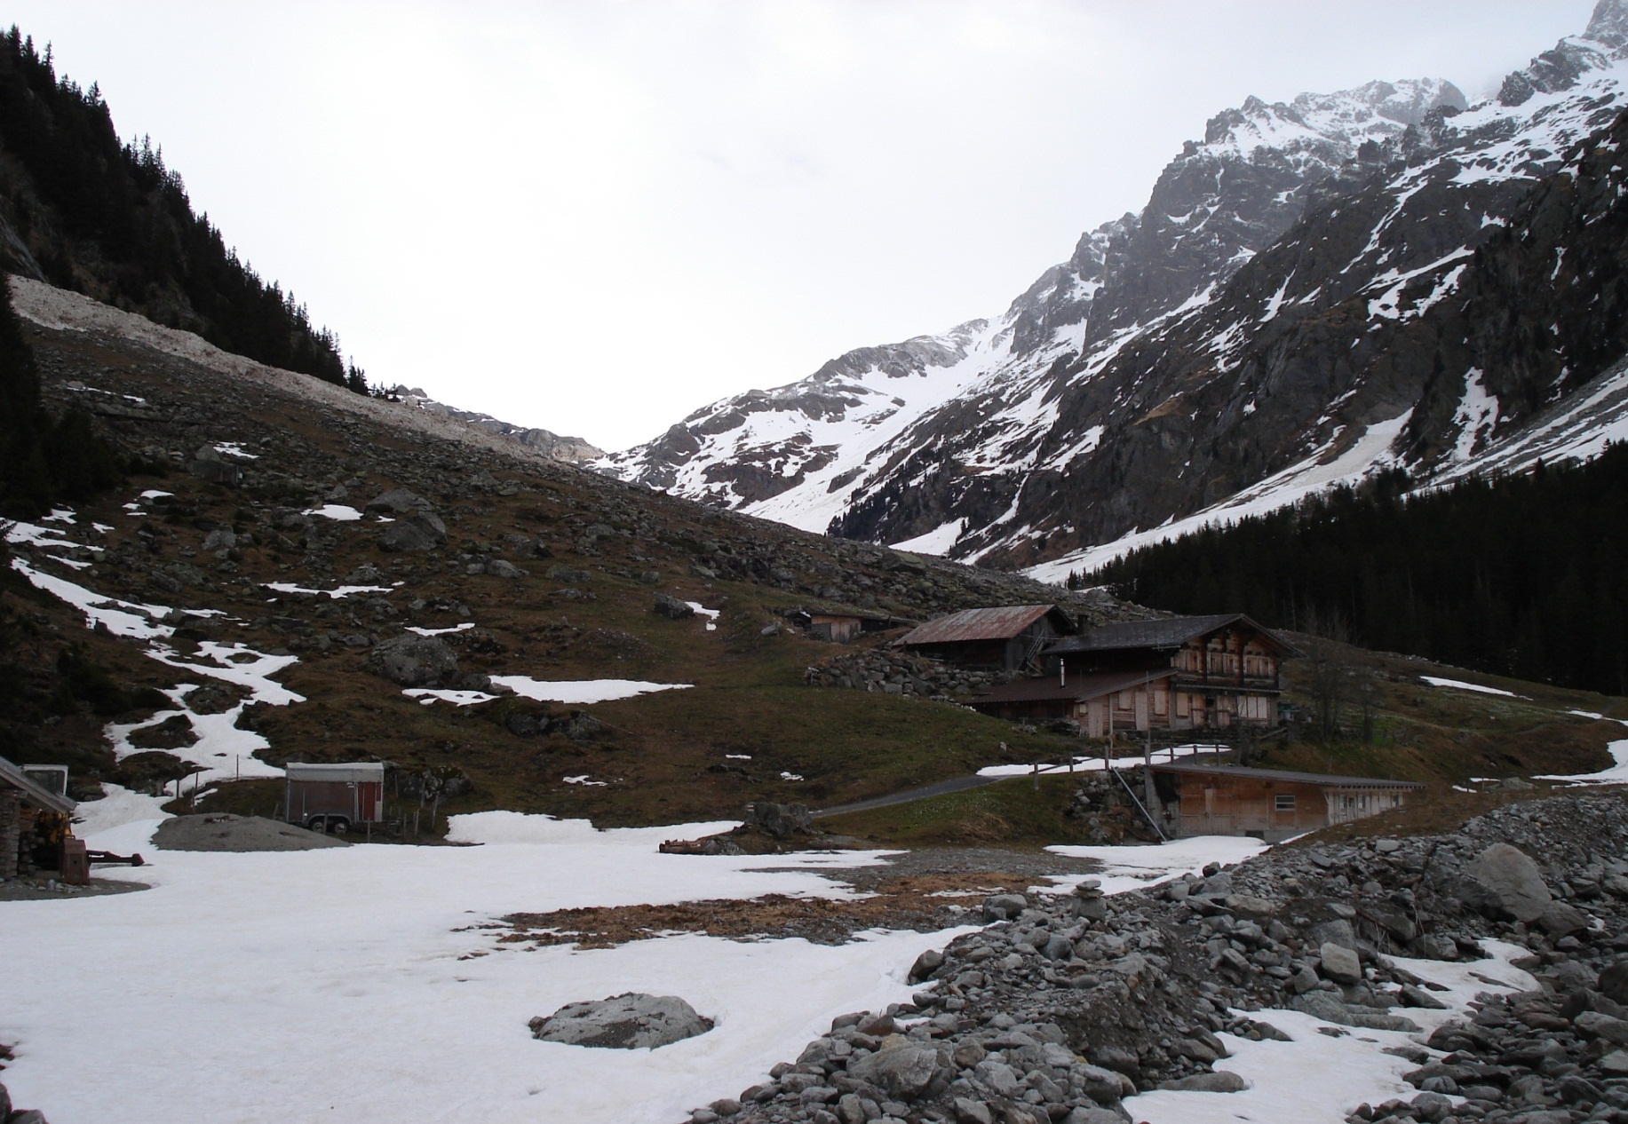
ION 21 Team System Portal

Slide 47
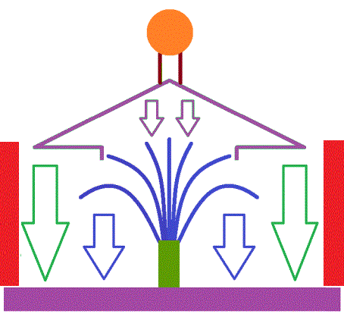
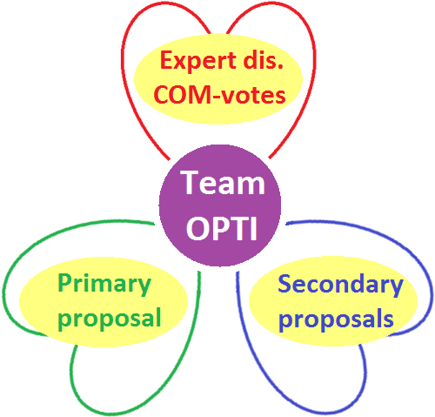
ION 21 Team System Portal
ION 21 Optimization: Trunk and branches of the Solution tree

Slide 48
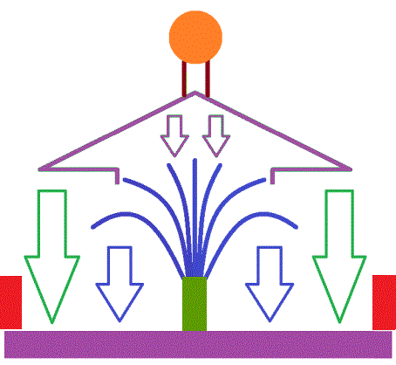
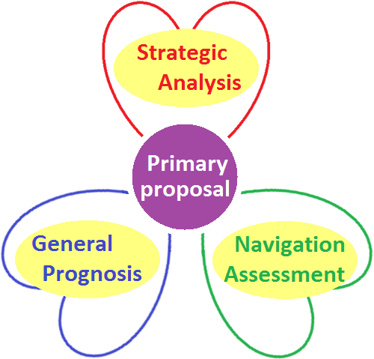
ION 21 Team System Portal
ION 21 Primary APA-proposal: Trunk of the Solution tree

Slide 49
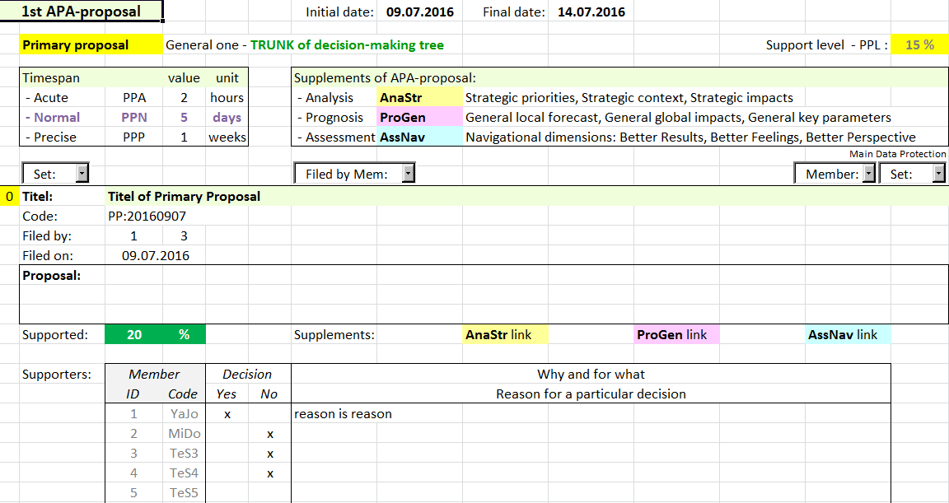
ION 21 Team System Portal
Primary APA-proposal: Strategic analysis, General prognosis, Navigation assessment

Slide 50
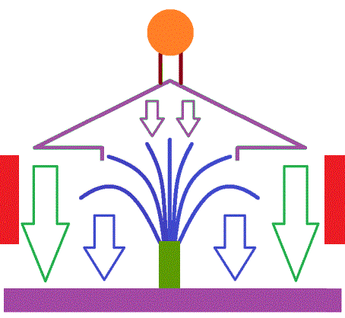
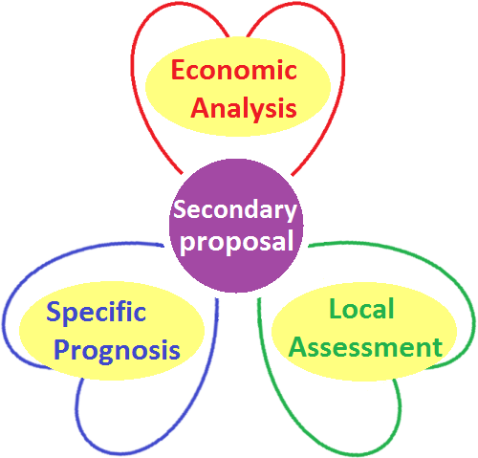
ION 21 Team System Portal
ION 21 Secondary APA-proposals: Branches of the Solution tree

Slide 51
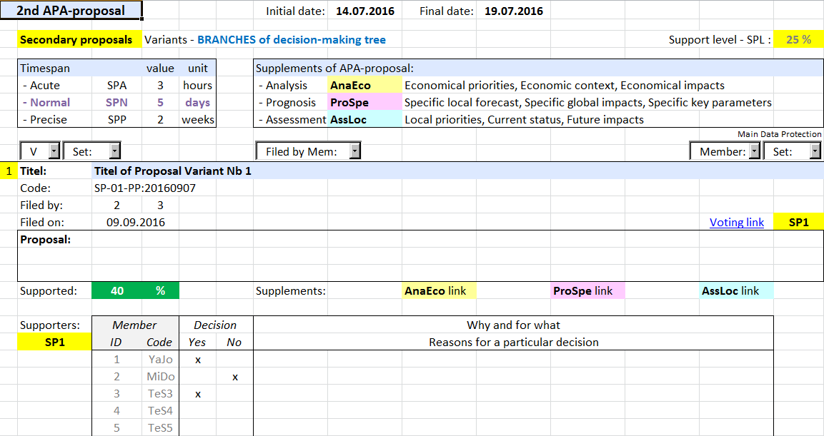
ION 21 Team System Portal
Secondary APA-proposals: Economical analysis, Specific prognosis, Local assessment

Slide 52
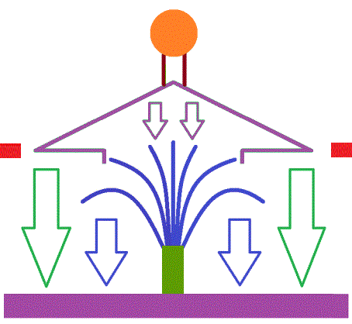
ION 21 Team System Portal
ION 21 Competency Votes Sharing

Slide 53
ION 21 Team System Portal

Slide 54
ION 21 Team System Portal
ION 21 Navigation : 1st + 2nd + 3rd Voting Round

Slide 55
ION 21 Team System Portal
ION 21 Navigation: First Voting Round

Slide 56
ION 21 Team System Portal
ION 21 Navigation: First Voting Round

Slide 57
ION 21 Team System Portal

Slide 58
ION 21 Team System Portal
ION 21 Navigation: Second Voting Round

Slide 59
ION 21 Team System Portal
ION 21 Navigation: Second Voting Round

Slide 60
ION 21 Team System Portal
ION 21 Navigation: Third Voting Round

Slide 61
ION 21 Team System Portal
ION 21 Navigation: Third Voting Round

Slide 62
ION 21 Team System Portal

Slide 63
ION 21 Team System Portal
Navigation APA-proposal: Ecological analysis, Parametric prognosis, Global assessment

Slide 64
ION 21 Team System Portal
Navigation Prognosis: Key parameters, Forecasted values, Tolerance intervals
The comparison of real a forecasted development in time intervals extending by a geometric progression (in 1, 2, 4, 8 … days/months/years) allows to set STOP state and realize another variant or correct the navigation prognosis published openly.

Slide 65
ION 21 Team System Portal
ION 21 Realization: Implementation team and Inspection team
The realization of Navigation proposal variant ensures Implementation team consisting of experts that have supported it and received the most Competency votes.
Inspection team may be formed from team members, who have supported the second alternative variant and received the most shared Competency votes.

Slide 66
ION 21 Team System Portal

Slide 67
ION 21 Team System Portal
ION 21 Hierarchy

Slide 68
ION 21 Team System Portal
ION 21 Boss Safeguard Rules
ION 21 Introducing, Testing and Implementation in an existing running company
can be conditioned by deployment of the following 3 Safeguards:
1st safeguard rule: Boss Veto Right – based on a proper explanation the submitted optimization proposal can be banned by the current Head (Boss, CEO)
2nd safeguard rule: Boss Income Right – the Better Results dimension of teamwork has to generate better financial income for each team member than the previous state
3rd safeguard rule: Boss Stop Right – in case of permanent deviations from the ION 21 navigation corridor the Stop State can be declared by the current Head

Slide 69
ION 21 Team System Portal

